Slide 1

ANTI-MONEY LAUNDERING DETECTION
GROUP -9
1.DEVANA-24213
2.AMRUTHA-24255
3.CHARAN TEJ REDDY-24259
4.ZAHWA-24261
DATA STRUCTURES-(111)
JAVA AND OOPS-(112)

Slide 2

INTRODUCTION
Money Laundering is disguising illicit financial transactions to appear legitimate.
It is a significant global challenge that threatens financial security and regulatory compliance
Advanced detection methods are required to counteract evolving laundering strategies.

Slide 3
PROBLEM STATEMENT
Money laundering networks operate through complex, multi-layered transactions.
Traditional rule-based systems fail to detect hidden and evolving laundering patterns
There is a need for graph-based anti-money laundering(AML) detection to efficiently identify suspicious transaction networks.

Slide 4
OBJECTIVES
To develop a graph-based approach for AML detection.
To implement Neo4j for transaction graph visualization and analysis.
Enhance fraud detection using Graph Neural Networks(GNNs).

Slide 5
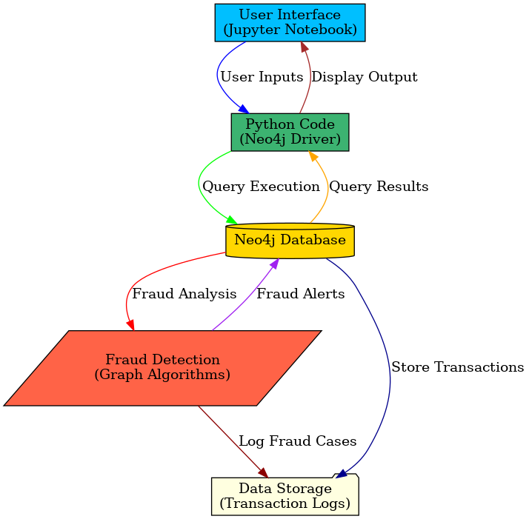
SYSTEM ARCHITECTURE

Slide 6
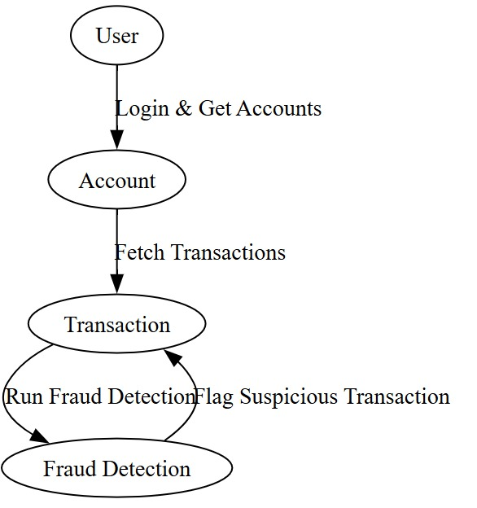
SEQUENCE DIAGRAM

Slide 7
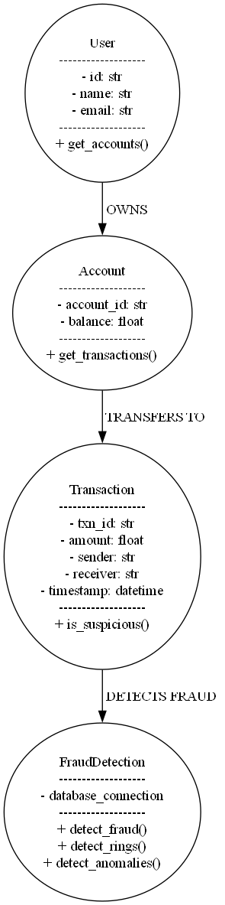
UML Diagram

Slide 8
DATASET
Dataset Summary:
Transactions Map Total Records: 4,507
Total Columns: 17
Key Columns:
id (Transaction ID)
Begin _ date, end _ date (Transaction period)
Originator _ bank, beneficiary _ bank (Involved banks)
Amount _ transactions (Transaction value)
Suspicious _ flag (Fraud label: True/False)
Data Types: Integer, Float, String, Boolean
Fraudulent Transactions: X (Replace with actual count)
Normal Transactions: Y (Replace with actual count)

Slide 9
MACHINE LEARNING APPROACH FOR AML DETECTION
Graph Neural Networks(GNNs) are employed for fraud detection.
Training is conducted using labelled data from the dataset.
Evaluation metrics
- Precision : Correctly identified fraudulent transactions.
- Recall : Coverage of actual fraudulent transactions.
- F1-score : Balance between precision and recall.

Slide 10
HOW OOPS COMES IN PLAY?
CONCEPT | ROLE IN AML
OOP(Classes and Objects) | Models ‘User, Account, Transaction, FraudDetection.’
Encapsulation | Protects sensitive transaction details.
Graph Data Structure | Represents transaction networks.
Graph Algorithms | Identifies fraud rings & suspicious transactions.
Hash Tables | Fast lookup of transaction history
Machine Learning(Random Forest, GNNs) | Predicts Fraud risk based on transaction features

Slide 11
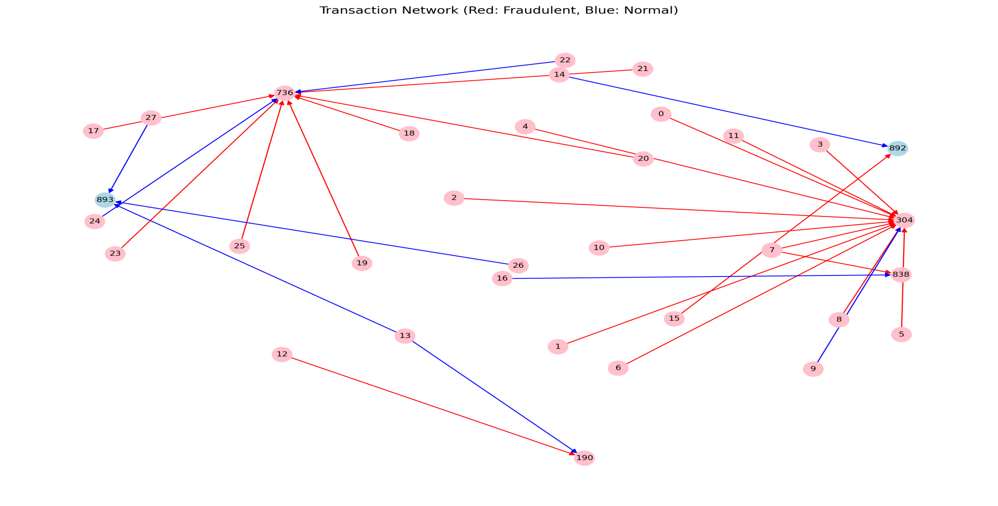
RESULTS

Slide 12
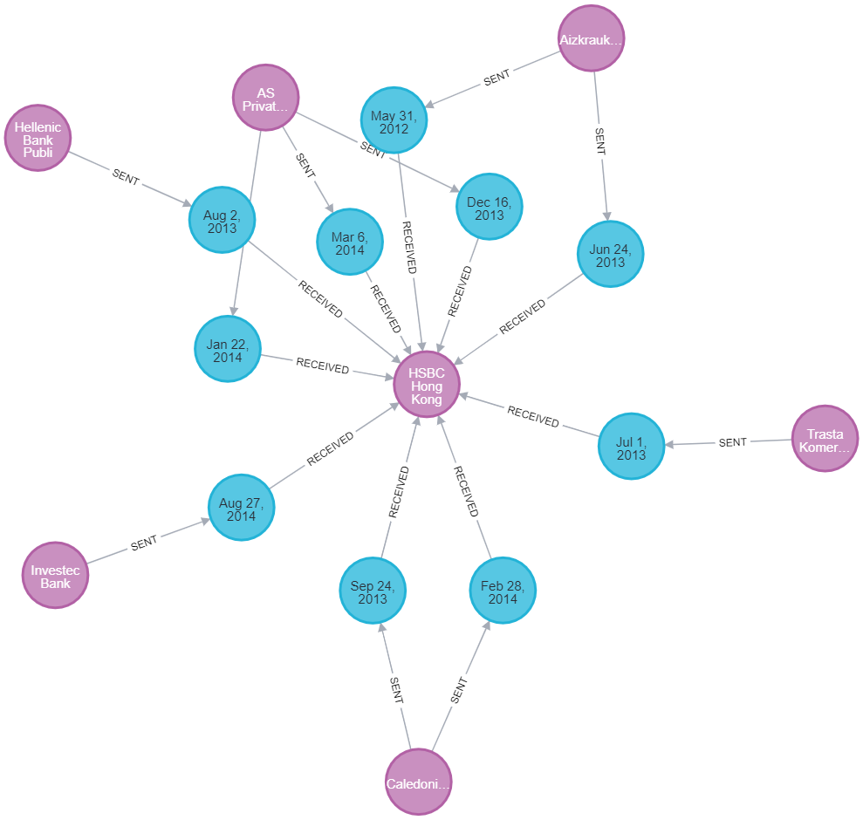

Slide 13
FUTURE ENHANCEMENT
Real-Time Detection: Implement a streaming GNN model for continuous transaction monitoring.
Explainability: Integrate Explainable AI (XAI) techniques like SHAP/LIME for transparent decision-making.
Scalability: Optimize graph algorithms to handle large-scale financial transaction datasets.

Slide 14
REFERNCES
Books & Research Papers
"Anti-Money Laundering: International Law and Practice" – Wouter H. Muller, Christian H. Kalin , John G. Goldsworth
"The Money Laundering Risk Detection System" – Research on machine learning for AML.

Slide 15
THANK YOU

